Slide 1
Installation Guide to Model-Based Design Toolbox BMS Series
McMaster Automotive Resource Centre (MARC)
Notes:
BMS Series Quick Start Guide: https://community.nxp.com/t5/NXP-Model-Based-Design-Tools/NXP-Model-Based-Design-Toolbox-for-Battery-Management-Systems/ta-p/2003771?profile.language=en&attachment-id=190255

Slide 2
Installation Guide to Model-Based Design Toolbox BMS Series
System Requirements
Criteria | Minimum Requirements
Operating Systems | Any Windows® x64 processor
RAM | 4 GB
Disk | 6 GB
Web Downloads | Internet
Operating System Supported
 | SP Level | 64-bit
Windows 10 |  | x
Windows 11 |  | x
Software Requirements
Toolbox Name | Version
Model-Based Design Toolbox for S32K3xx | 1.4.x
Notes:
NXP Model-Based Design Toolbox Team (2025). NXP_Support_Package_BMS (https://www.mathworks.com/matlabcentral/fileexchange/155682-nxp_support_package_bms), MATLAB Central File Exchange. Retrieved July 28, 2025.

Slide 3
Installation Guide to Model-Based Design Toolbox S32K3xx Series
MathWorks Product Requirements
Product Name | Version
Simulink | R2020a or later
Embedded Coder | R2020a or later
MATLAB Coder | R2020a or later
Simulink Coder | R2020a or later
Stateflow | R2020a or later

Slide 4
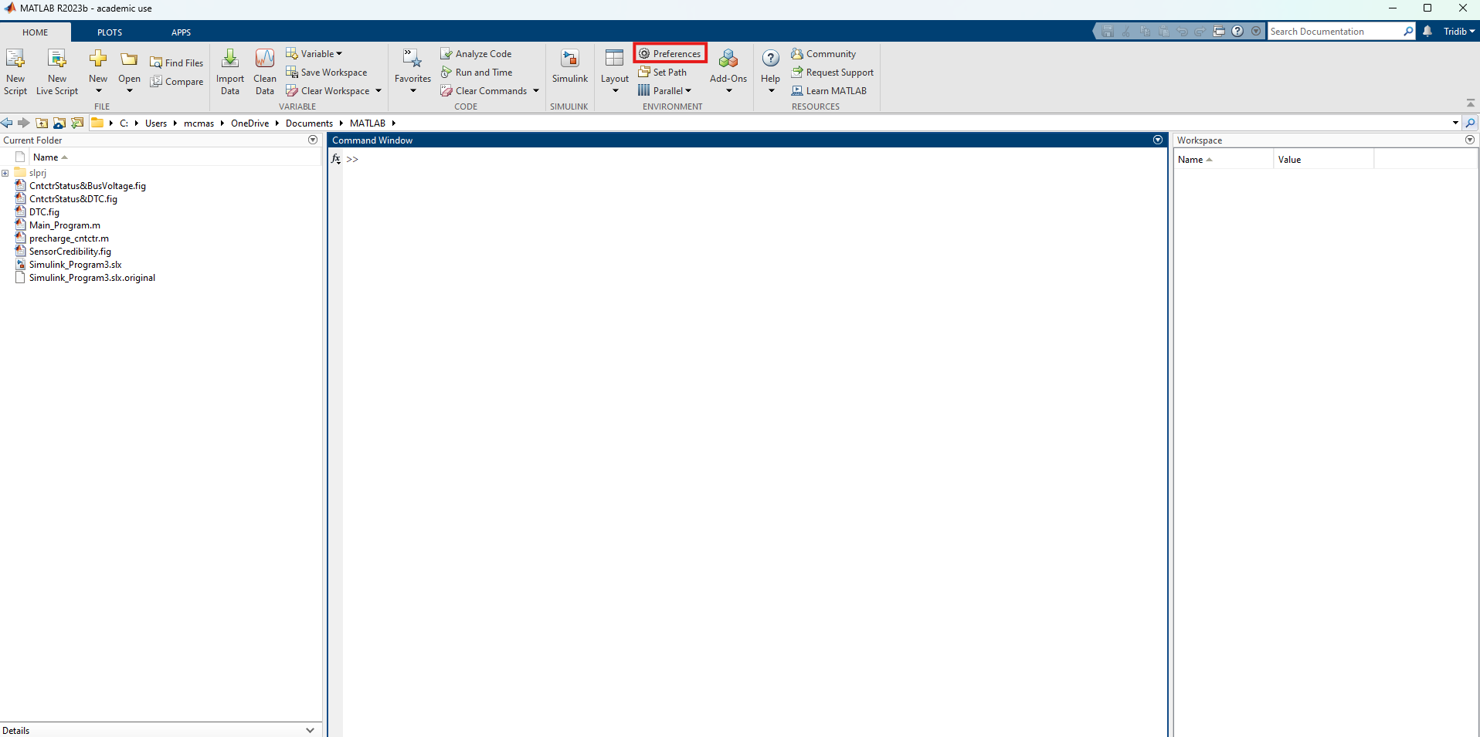
Installation Guide to Model-Based Design Toolbox BMS Series
Installation Steps: NXP Support Package for BMS (Version 1.1.0)
1. First, take a note of where the MathWorks Add-ons are installed by default on your computer. To do that, press Preferences from the Home tab of the MATLAB homepage.

Slide 5
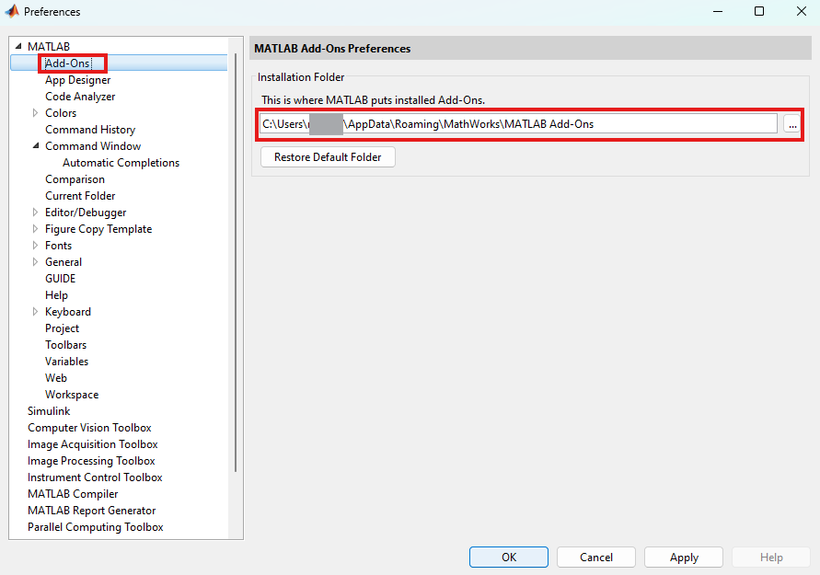
Installation Guide to Model-Based Design Toolbox BMS Series
Installation Steps: NXP Support Package for BMS (Version 1.1.0)
2. In the pop-up window, press Add-Ons from MATLAB drop-down. Take a note of the full path of where MATLAB puts installed Add-Ons.
Note: It is recommended to install the MATLAB and NXP Toolbox into a location that does not contains special characters, empty spaces, or mapped drives.

Slide 6
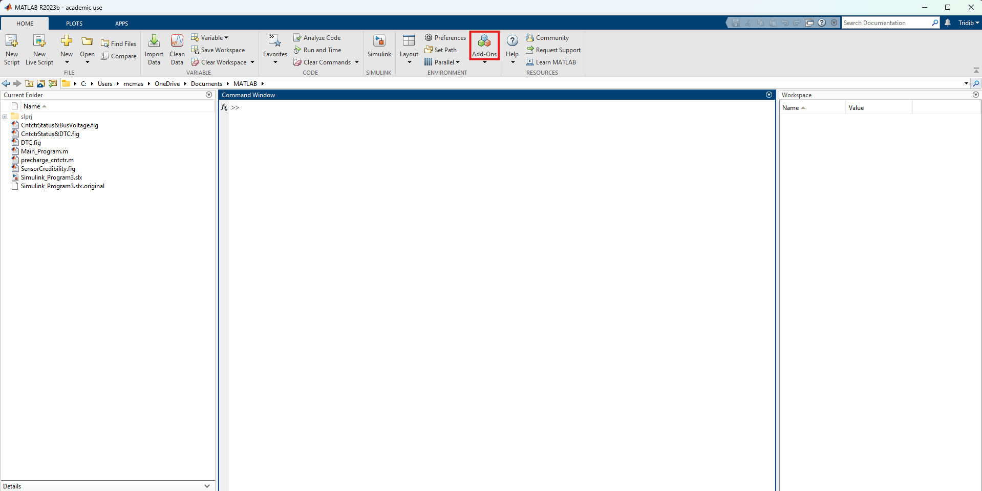
Installation Guide to Model-Based Design Toolbox BMS Series
Installation Steps: NXP Support Package for BMS (Version 1.1.0)
3. To install, first press Add-Ons from Home tab.

Slide 7
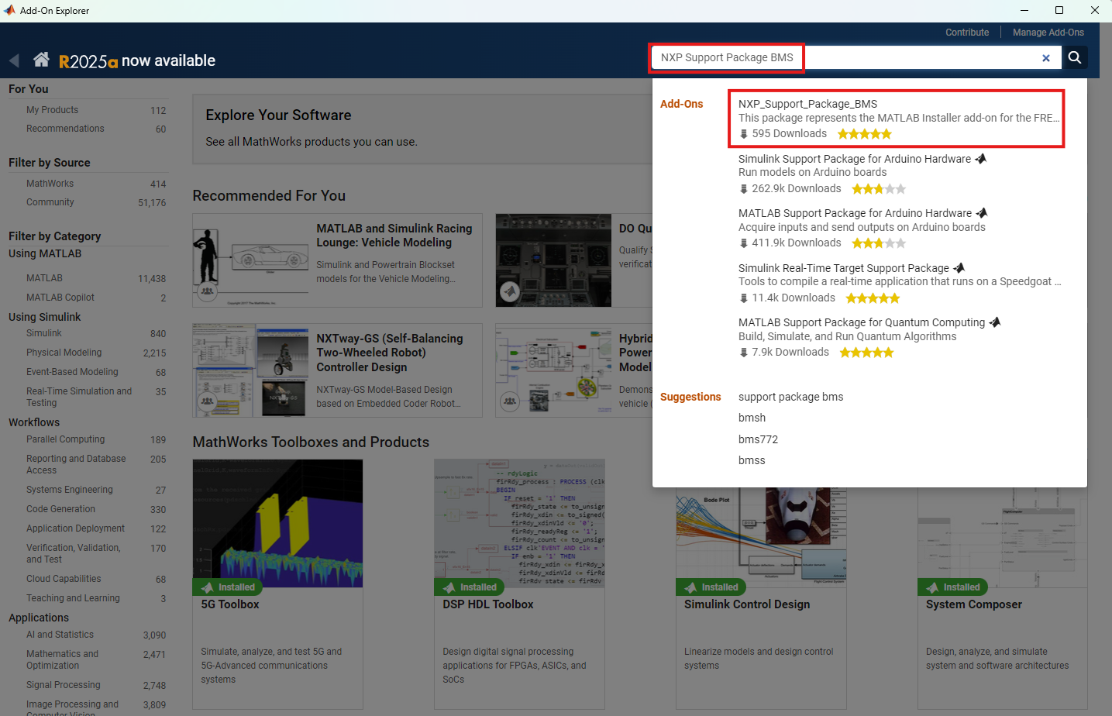
Installation Guide to Model-Based Design Toolbox BMS Series
Installation Steps: NXP Support Package for BMS (Version 1.1.0)
4. Search for "NXP Support Package BMS" and press the first search result.

Slide 8
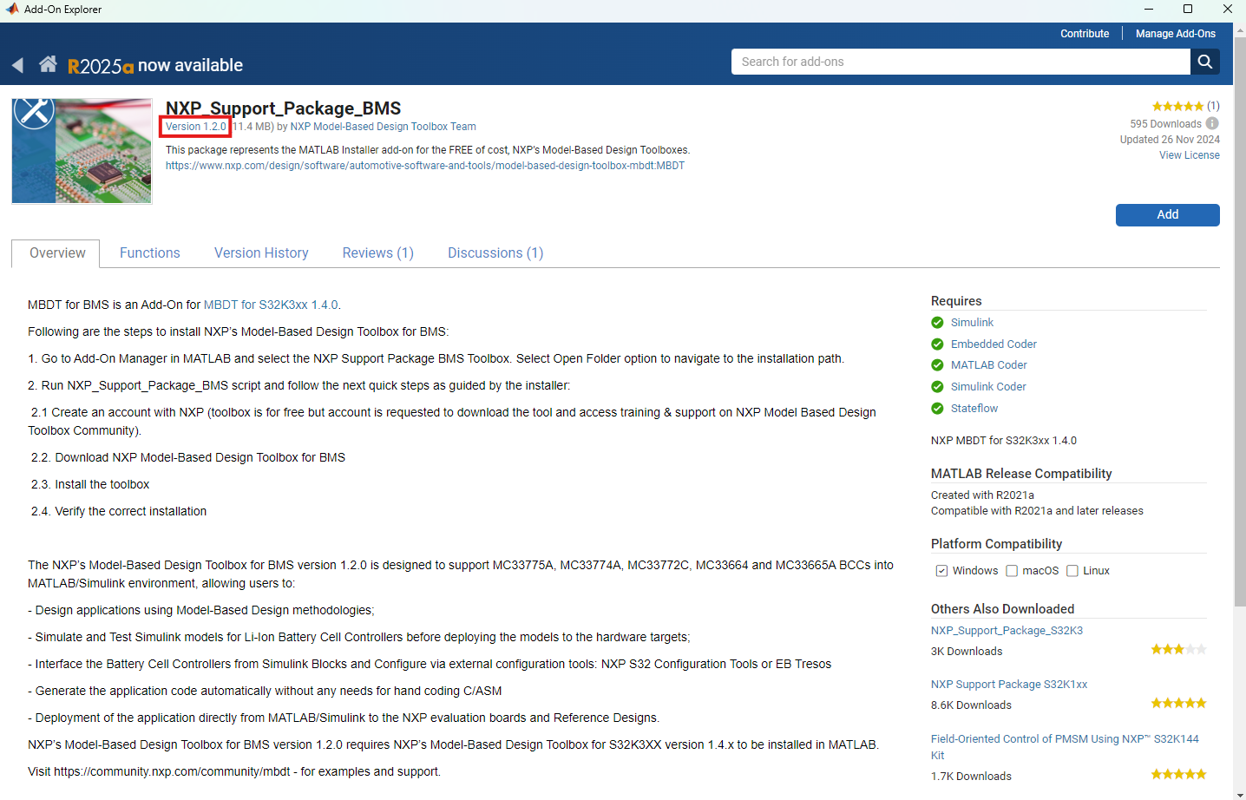
Installation Guide to Model-Based Design Toolbox BMS Series
Installation Steps: NXP Support Package for BMS (Version 1.1.0)
5. If you want to install a different version, click on the link Version x.x.x

Slide 9
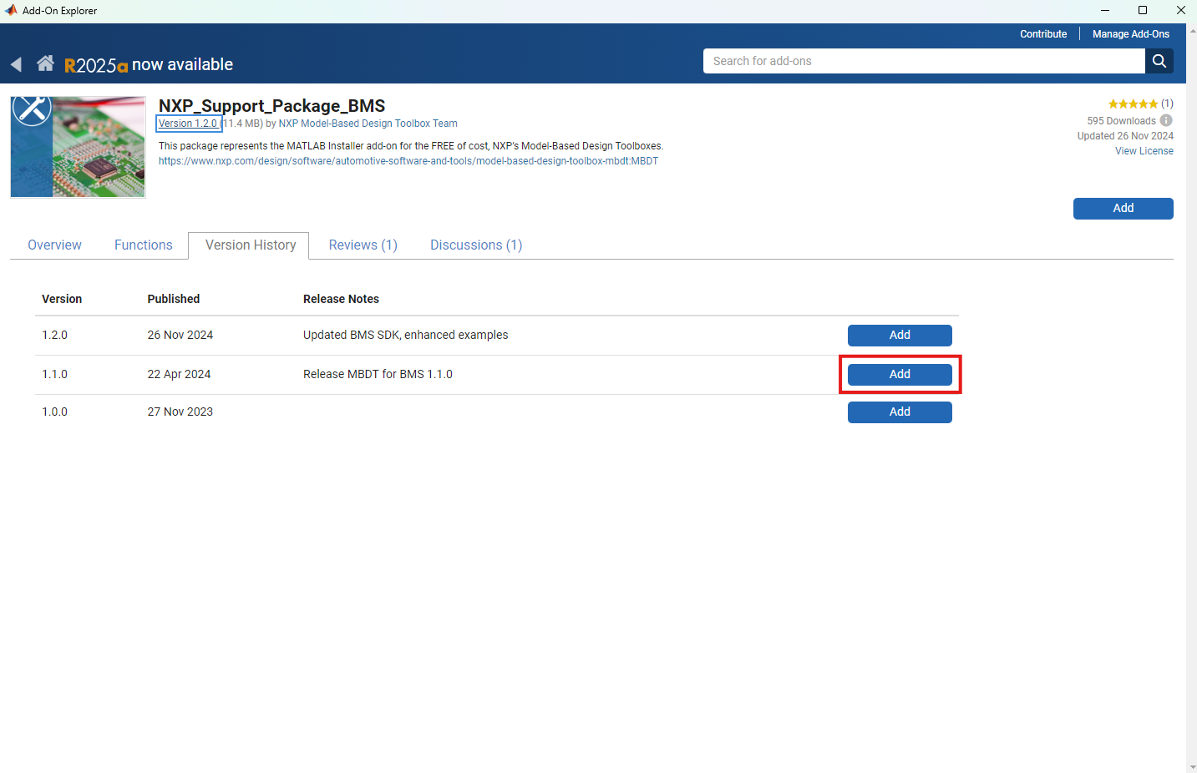
Installation Guide to Model-Based Design Toolbox BMS Series
Installation Steps: NXP Support Package for BMS (Version 1.1.0)
6. From this new page, you can choose a different version by pressing Add. For example, to install version 1.1.0, press the corresponding Add button.

Slide 10
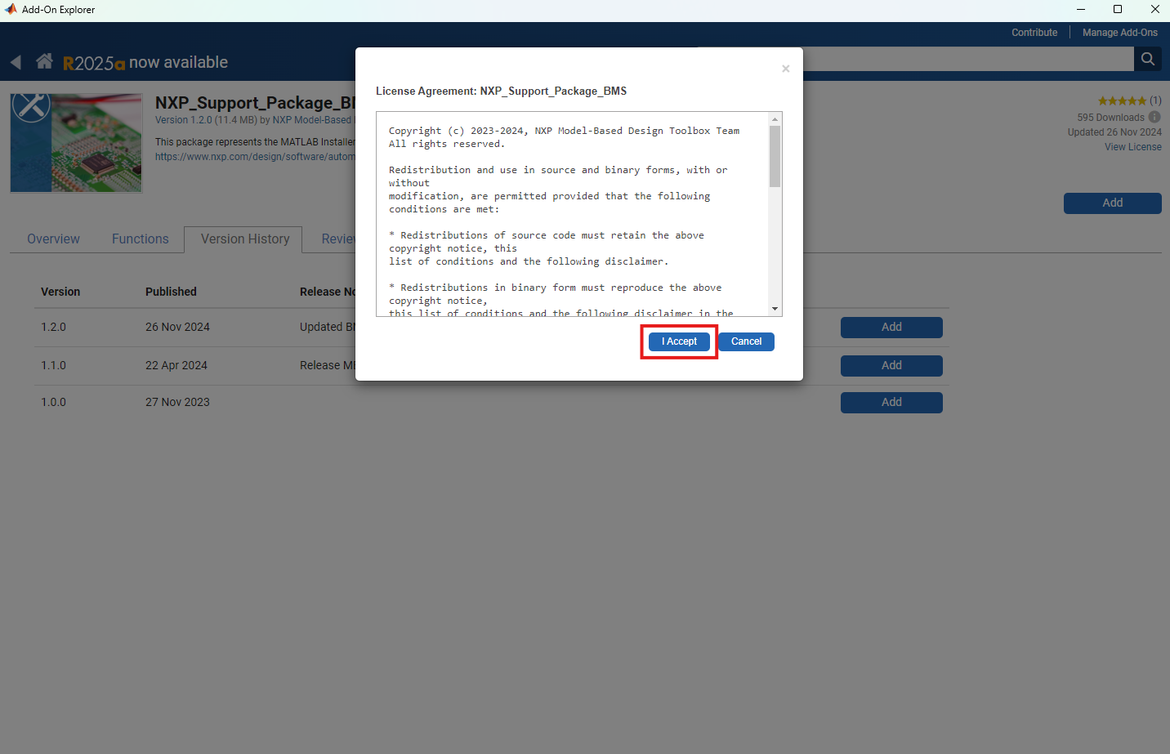
Installation Guide to Model-Based Design Toolbox BMS Series
Installation Steps: NXP Support Package for BMS (Version 1.1.0)
7. Read the License Agreement and press I Accept.

Slide 11
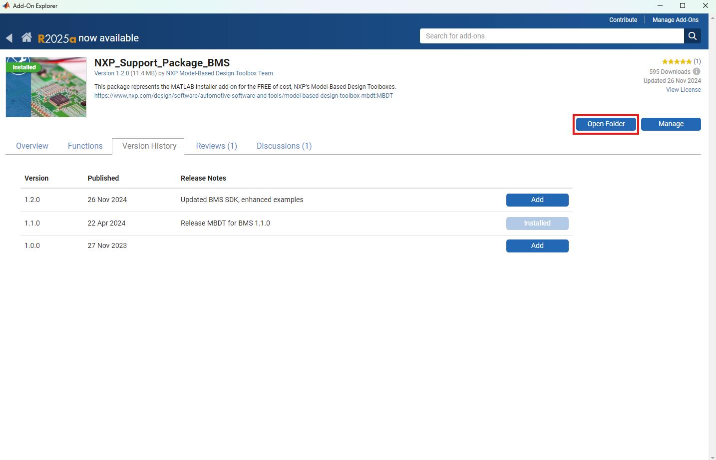
Installation Guide to Model-Based Design Toolbox BMS Series
Installation Steps: NXP Support Package for BMS (Version 1.1.0)
8. Once the process is successful, press the Open Folder button.

Slide 12
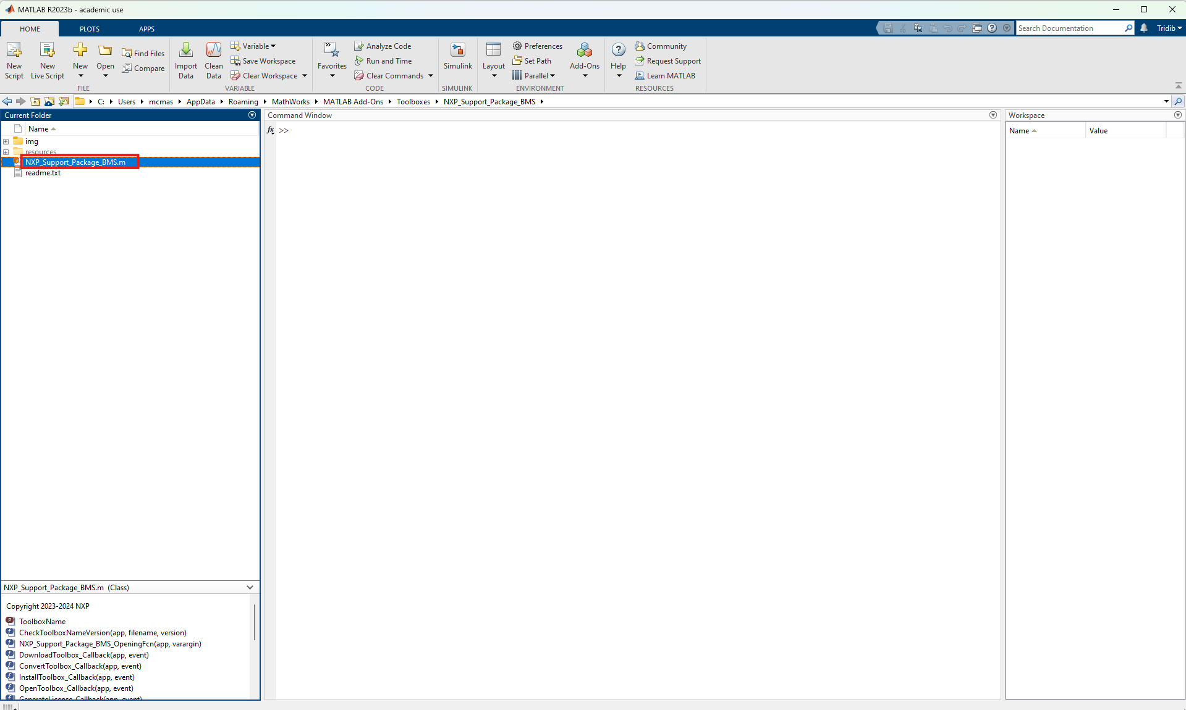
Installation Guide to Model-Based Design Toolbox BMS Series
Installation Steps: NXP Support Package for BMS (Version 1.1.0)
9. Open the NXP_Support_Package_BMS.m script by double-clicking it.

Slide 13
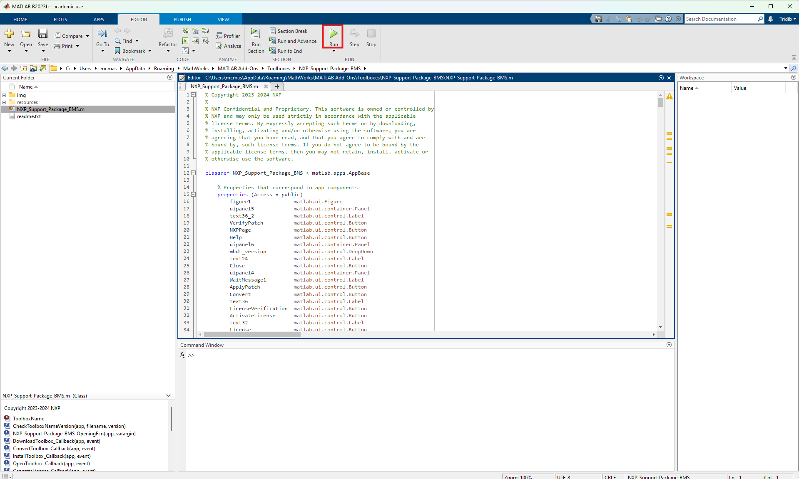
Installation Guide to Model-Based Design Toolbox BMS Series
Installation Steps: NXP Support Package for BMS (Version 1.1.0)
10. Run the script by pressing the Run button. It will start the NXP Support Package for BMS.

Slide 14
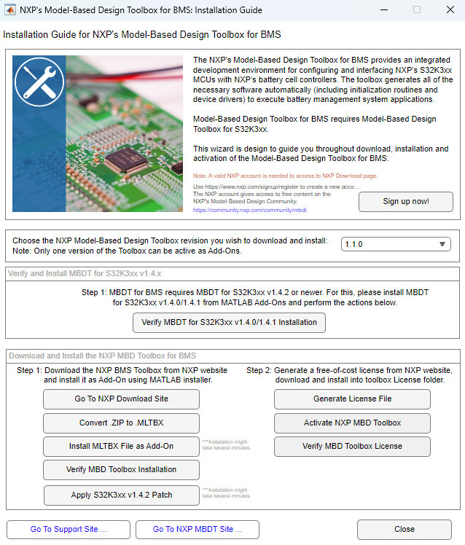
Installation Guide to Model-Based Design Toolbox BMS Series
Installation Steps: NXP Model-Based Design Toolbox for BMS (version 1.1.0)
11. A new pop-up window will appear. NXP Support Package for BMS is a graphical user interface guide that helps to download and install the Model-Based Design Toolbox and also generates and installs the free-of cost license from the NXP website.

Slide 15
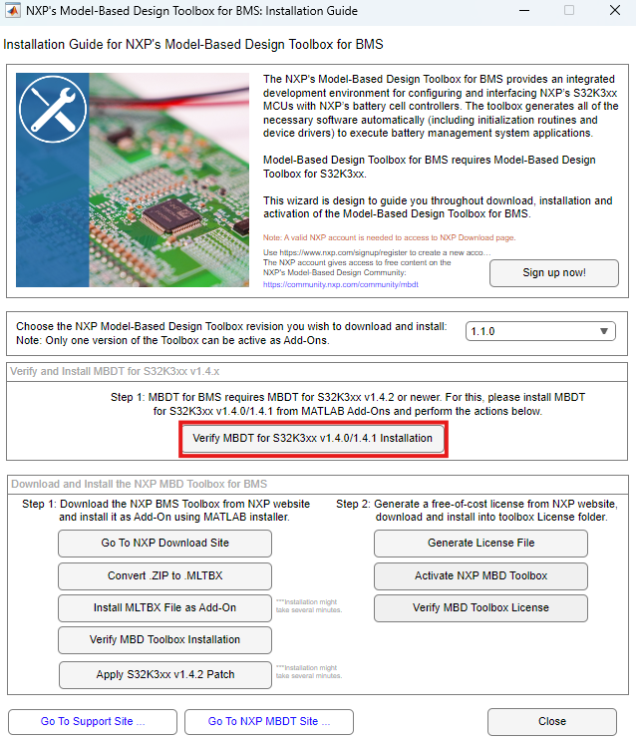
Installation Guide to Model-Based Design Toolbox BMS Series
Installation Steps: NXP Model-Based Design Toolbox for BMS (version 1.1.0)
11. Verify MBDT for S32K3xx v1.4.x Installation MBDT for BMS 1.2.0 requires MBDT for S32K3xx 1.4.0, 1.4.1 or 1.4.2 to be installed and configured in the current MATLAB instance. Press Verify MBDT for S32K3xx v1.4.0 Installation. Note: If MBDT for S32K3xx is not installed or you have a different version than 1.4.x, please proceed to install first the MBDT for S32K3xx 1.4.0!

Slide 16
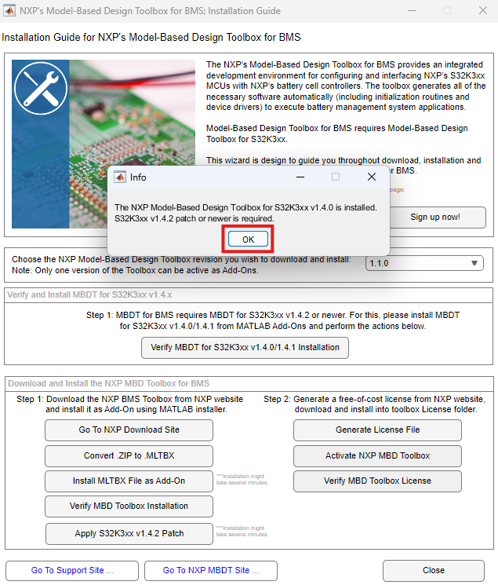
Installation Guide to Model-Based Design Toolbox BMS Series
Installation Steps: NXP Model-Based Design Toolbox for BMS (version 1.1.0)
12. In the pop-up window, press OK.

Slide 17
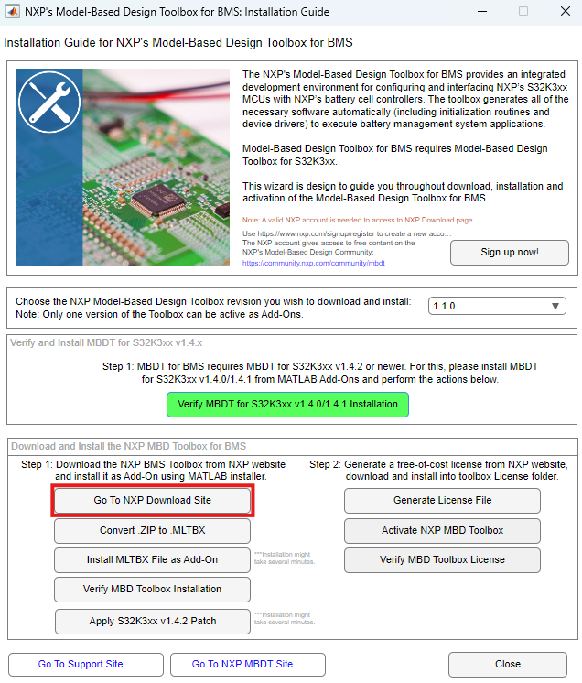
Installation Guide to Model-Based Design Toolbox BMS Series
Installation Steps: NXP Model-Based Design Toolbox for BMS (version 1.1.0)
12. The previous step is highlighted by green color means you are good to go to the next step. Press Go to NXP Download Site Button.

Slide 18
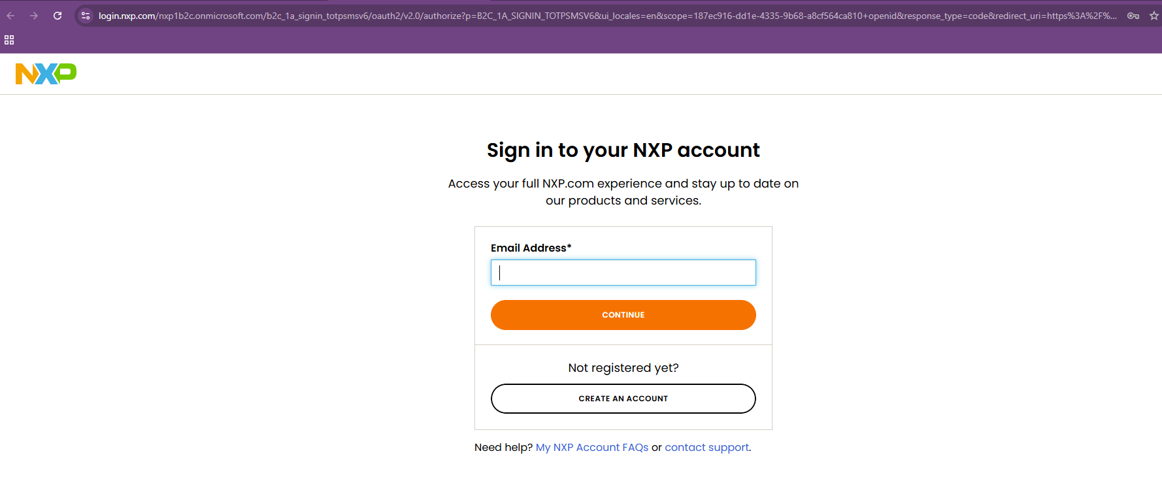
Installation Guide to Model-Based Design Toolbox BMS Series
Installation Steps: NXP Model-Based Design Toolbox for BMS (version 1.1.0)
13. Sign in to NXP. If you already have no account with NXP, create one.

Slide 19
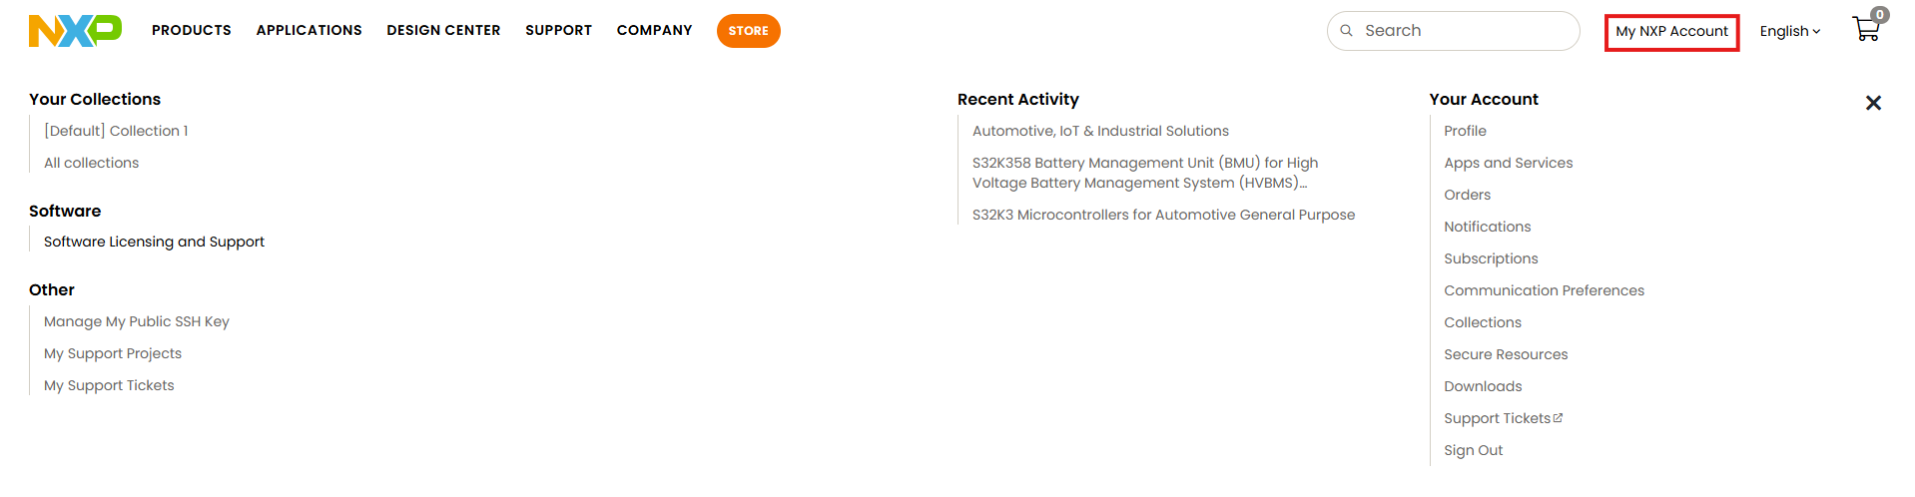
Installation Guide to Model-Based Design Toolbox BMS Series
Installation Steps: NXP Model-Based Design Toolbox for BMS (version 1.1.0)
14. After signing in, the landing page will likely be your profile page. Click on My NXP Account from top right.

Slide 20
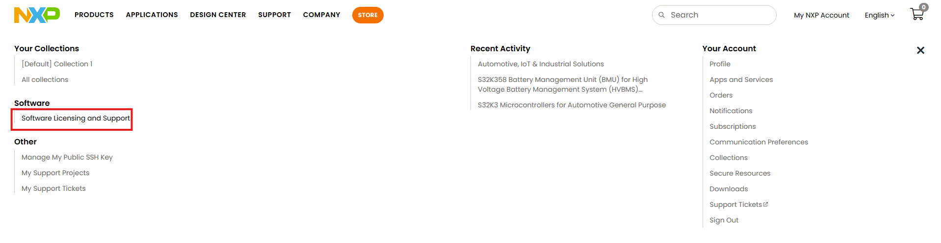
Installation Guide to Model-Based Design Toolbox BMS Series
Installation Steps: NXP Model-Based Design Toolbox for BMS (version 1.1.0)
15. Next, click on Software Licensing and Support.

Slide 21
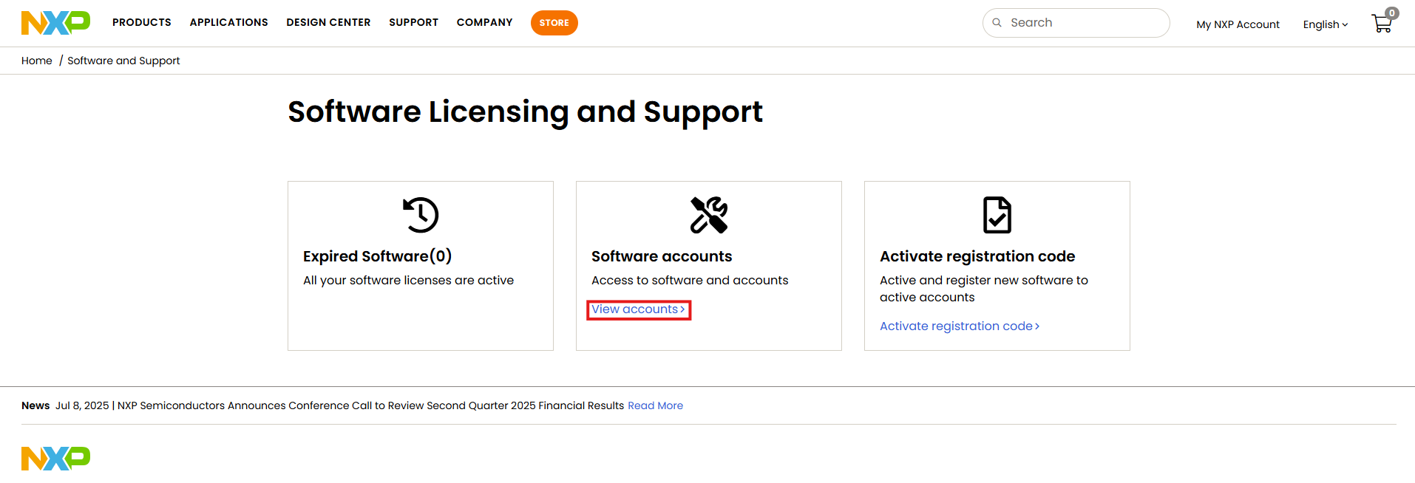
Installation Guide to Model-Based Design Toolbox BMS Series
Installation Steps: NXP Model-Based Design Toolbox for BMS (version 1.1.0)
16. In the new page, click on View accounts.

Slide 22
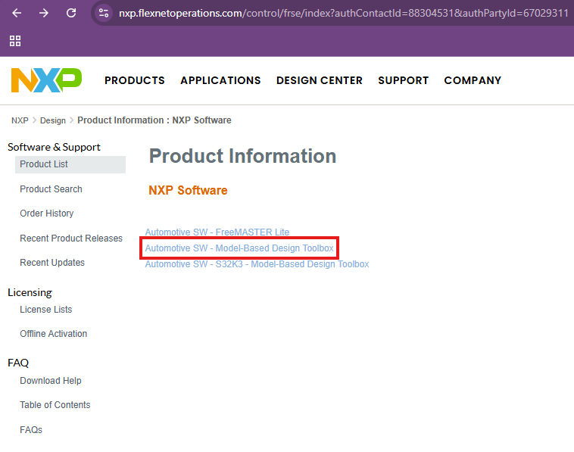
Installation Guide to Model-Based Design Toolbox BMS Series
Installation Steps: NXP Model-Based Design Toolbox for BMS (version 1.1.0)
17. Click on Automotive SW - Model-Based Design Toolbox.

Slide 23
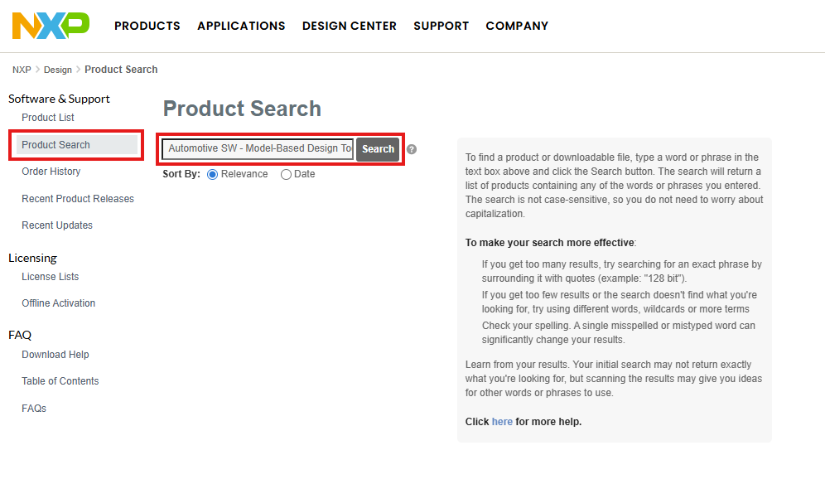
Installation Guide to Model-Based Design Toolbox BMS Series
Installation Steps: NXP Model-Based Design Toolbox for BMS (version 1.1.0)
18. Alternatively, you can search for it from Product Search.

Slide 24
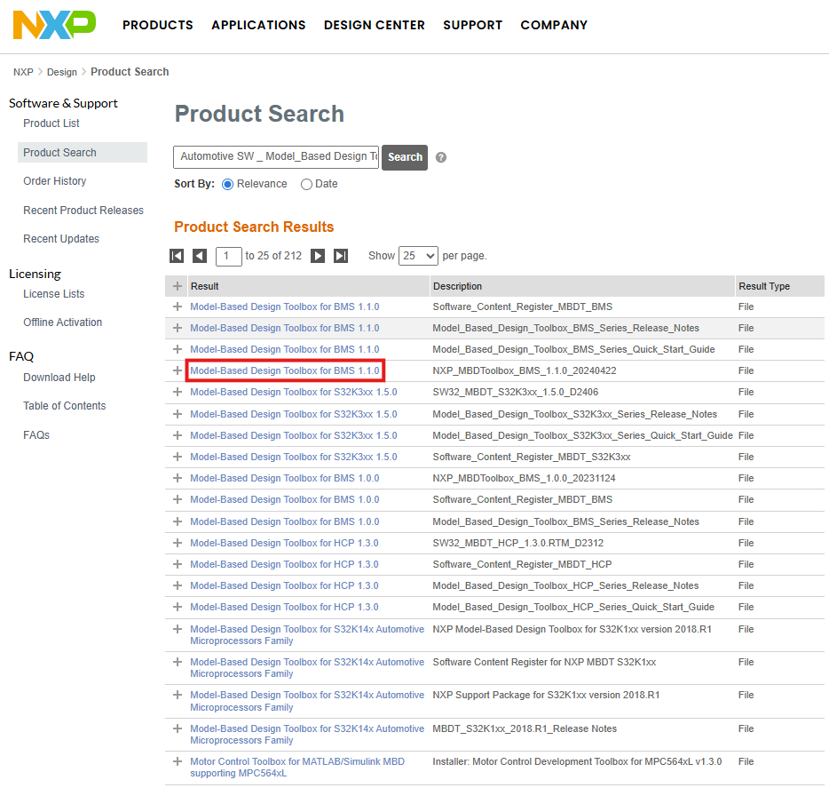
Installation Guide to Model-Based Design Toolbox BMS Series
Installation Steps: NXP Model-Based Design Toolbox for BMS (version 1.1.0)
19. Choose the corresponding version. Since the previously downloaded NXP Support Package BMS was version 1.1.0, NXP Model-Based Design Toolbox for BMS should be 1.1.0. Choose the one with description NXP_MBDToolbox_BMS_1.1.0_20240422

Slide 25
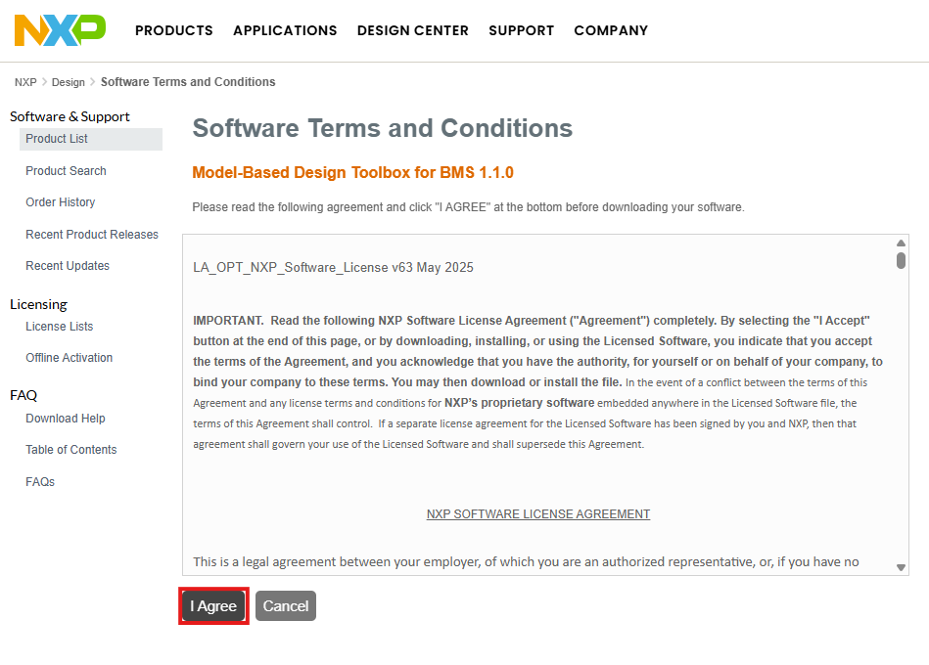
Installation Guide to Model-Based Design Toolbox BMS Series
Installation Steps: NXP Model-Based Design Toolbox for BMS (version 1.1.0)
20. Press I Agree.

Slide 26
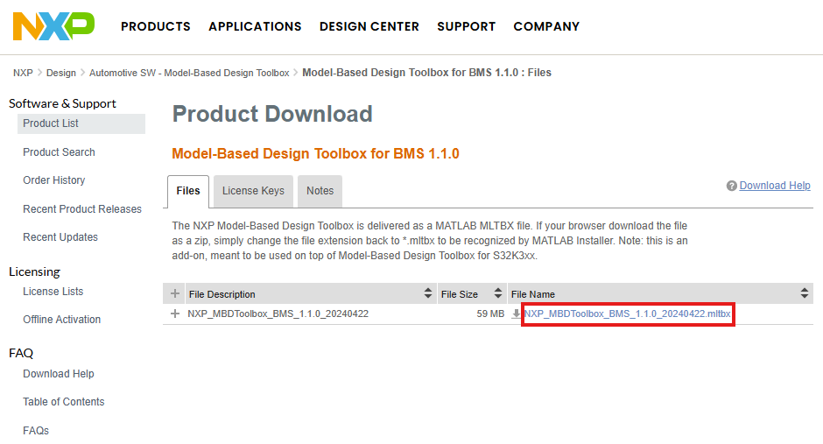
Installation Guide to Model-Based Design Toolbox BMS Series
Installation Steps: NXP Model-Based Design Toolbox for BMS (version 1.1.0)
21. Download the NXP_MBDToolbox_BMS_x.x.x_yyyymmdd.mltbx file.

Slide 27
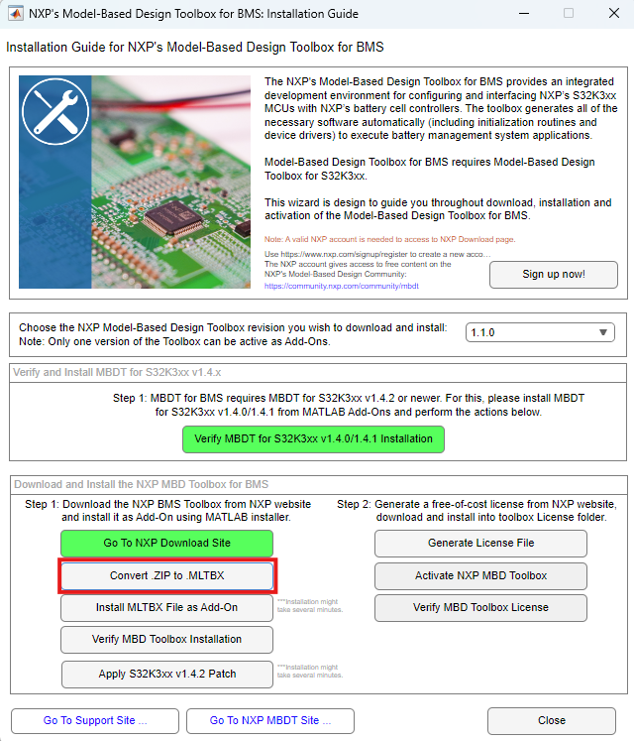
Installation Guide to Model-Based Design Toolbox BMS Series
Installation Steps: NXP Model-Based Design Toolbox for BMS (version 1.1.0)
22. Go back to NXP Support Package for BMS and press the Convert .ZIP to .MLTBX button.

Slide 28
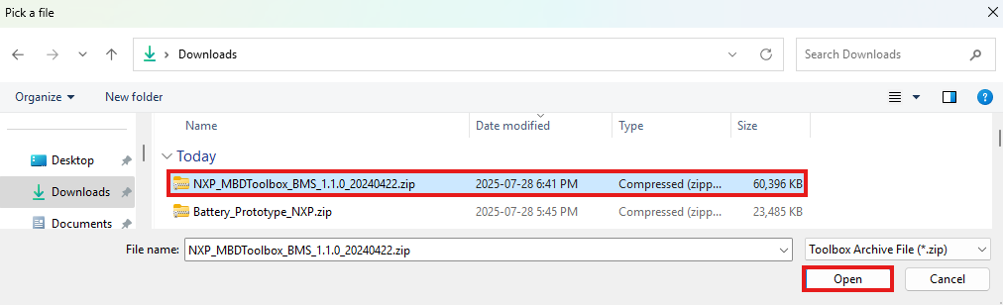
Installation Guide to Model-Based Design Toolbox BMS Series
Installation Steps: NXP Model-Based Design Toolbox for BMS (version 1.1.0)
23. In the newly opened Browsing window, select the file downloaded and press Open.

Slide 29
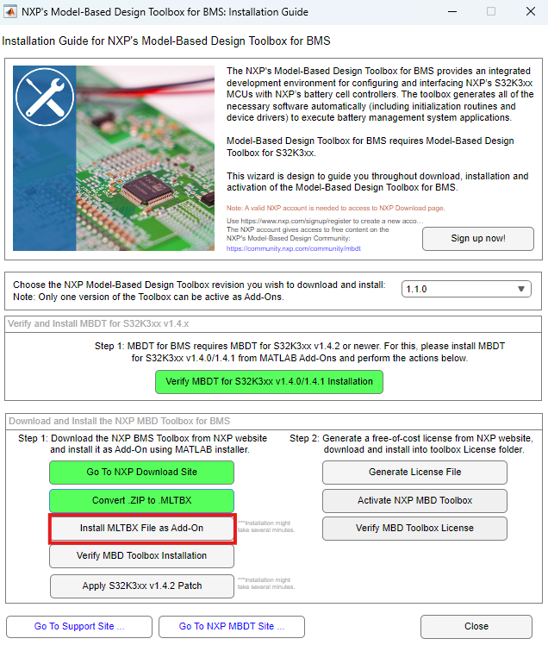
Installation Guide to Model-Based Design Toolbox BMS Series
Installation Steps: NXP Model-Based Design Toolbox for BMS (version 1.1.0)
24. Go back to NXP Support Package for BMS and select the Install MLTBX File as Add-On button.

Slide 30
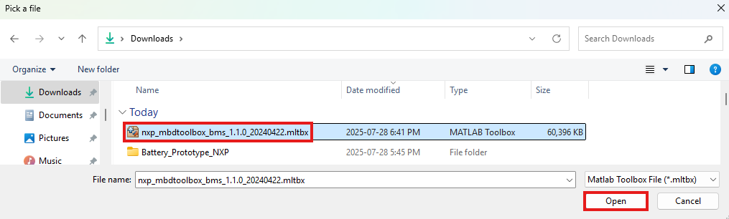
Installation Guide to Model-Based Design Toolbox BMS Series
Installation Steps: NXP Model-Based Design Toolbox for BMS (version 1.1.0)
25. In the newly opened window, browse for the MLTBX file and press Open.

Slide 31
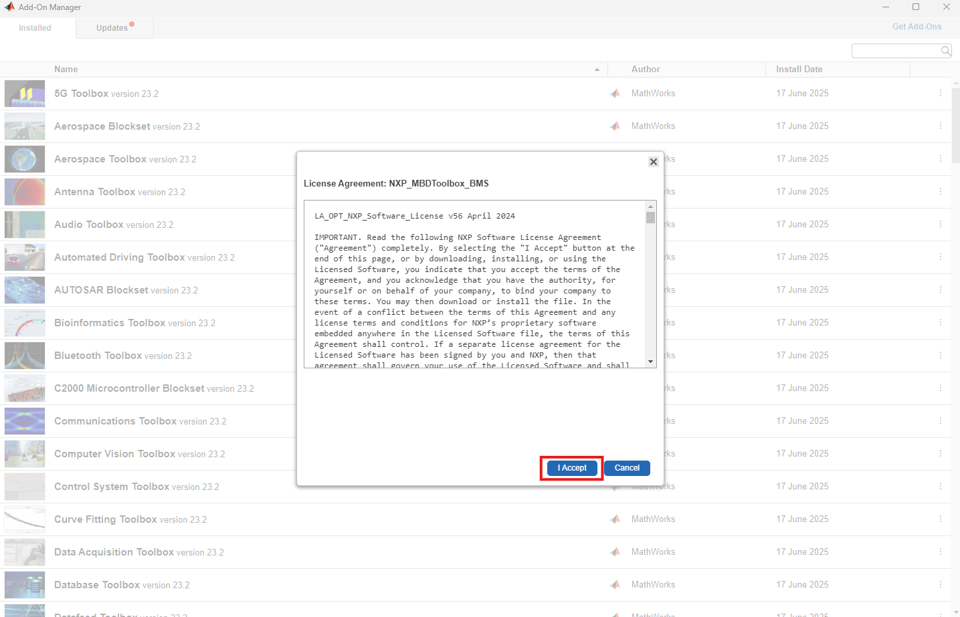
Installation Guide to Model-Based Design Toolbox BMS Series
Installation Steps: NXP Model-Based Design Toolbox for BMS (version 1.1.0)
26. In the MATLAB Add-On Manager, Review the Terms and Conditions as you scroll down, and press I Accept Button. This action starts MBDT for BMS Toolbox installation process.
Note: Installation might take several minutes

Slide 32
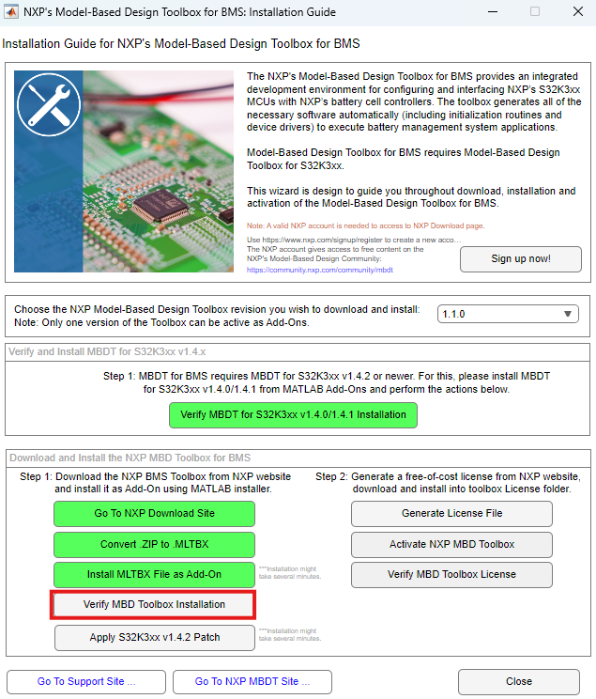
Installation Guide to Model-Based Design Toolbox BMS Series
Installation Steps: NXP Model-Based Design Toolbox for BMS (version 1.1.0)
27. Once the installation is complete, go back to NXP Support Package for BMS and press the Verify MBD Toolbox Installation button.

Slide 33
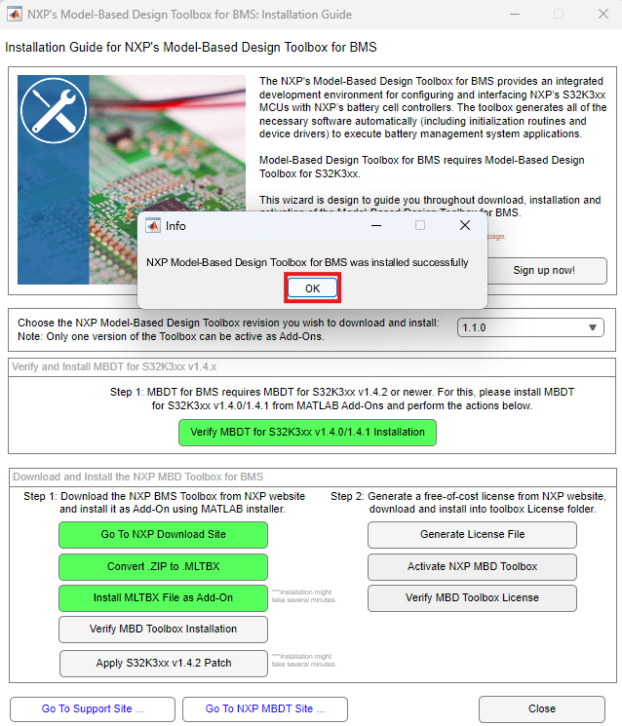
Installation Guide to Model-Based Design Toolbox BMS Series
Installation Steps: NXP Model-Based Design Toolbox for BMS (version 1.1.0)
28. In the pop-up window, press OK.

Slide 34
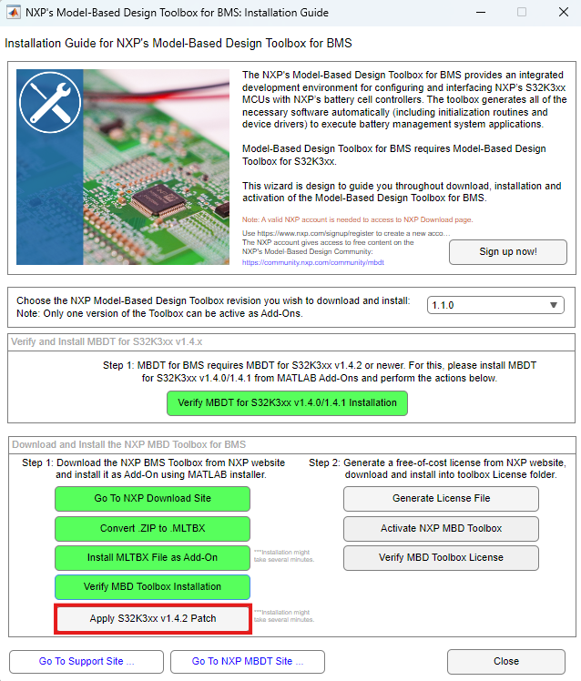
Installation Guide to Model-Based Design Toolbox BMS Series
Installation Steps: NXP Model-Based Design Toolbox for BMS (version 1.1.0)
28. Update MBDT for S32K3xx 1.4.0/1.4.1 to version 1.4.2, by pressing the Apply S32K3xx v1.4.2 Patch.

Slide 35
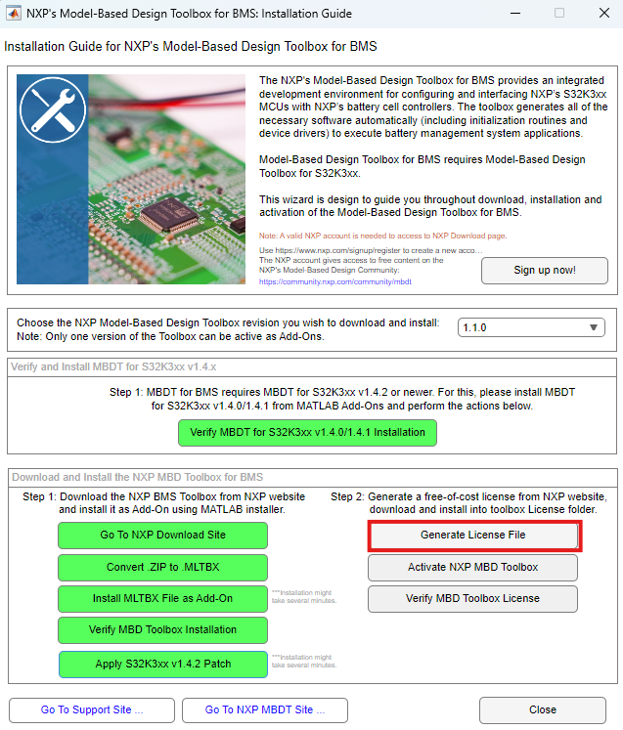
Installation Guide to Model-Based Design Toolbox BMS Series
Installation Steps: Generate and Activate NXP MBDT for BMS license
29. Even the MBDT for BMS is free-of-charge, users still need to generate and install a free license. First, press the Generate License File button in the NXP Support Package for BMS.

Slide 36
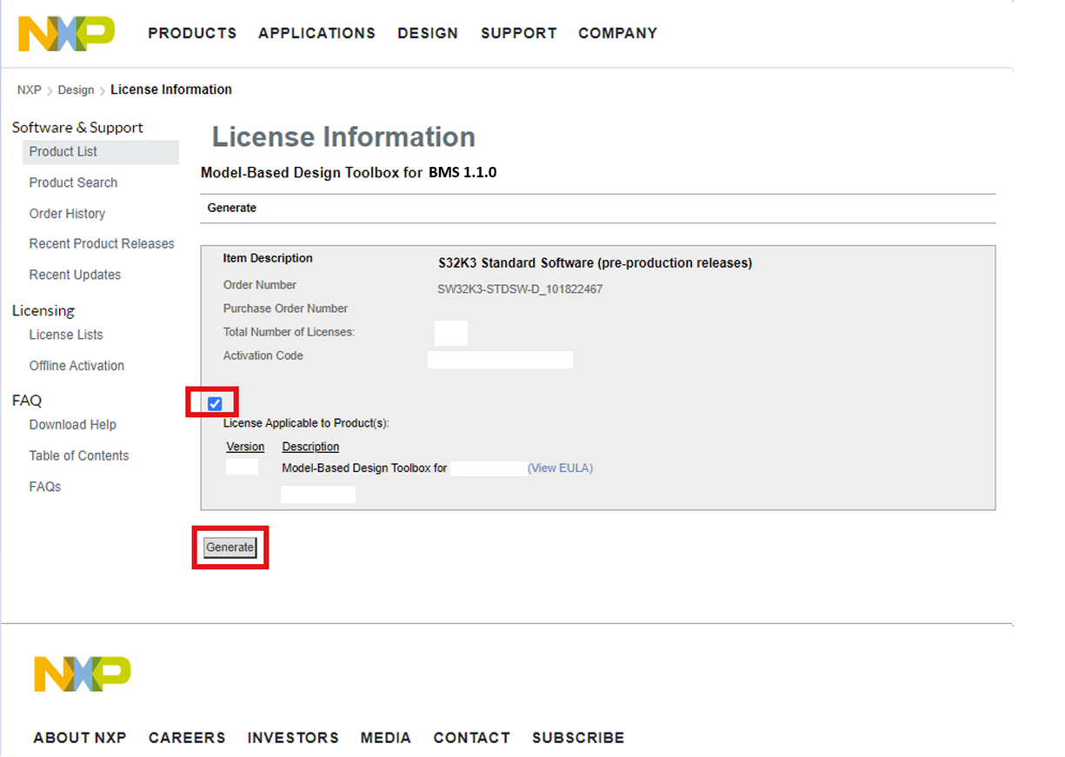
Installation Guide to Model-Based Design Toolbox BMS Series
Installation Steps: Generate and Activate NXP MBDT for BMS license
30. In the newly opened webpage, select the checkbox as shown below, and press the generate button.
Note: If this page does not show up, you have to go to My NXP Account > Software Licensing and Support > View accounts > Automotive SW - Model-Based Design Toolbox as shown in previous steps a few slides ago.

Slide 37
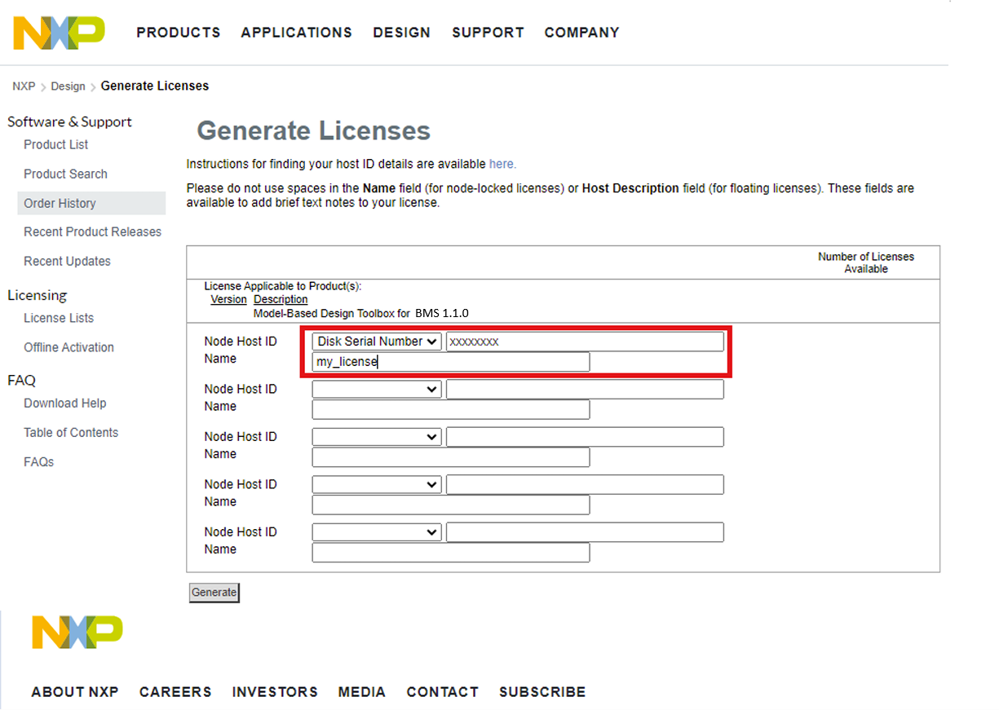
Installation Guide to Model-Based Design Toolbox BMS Series
Installation Steps: Generate and Activate NXP MBDT for BMS license
31. Select Disk Serial Number, and type the host id number. Give a name to the license, and press the Generate button. To find the host ID, follow the next step.

Slide 38
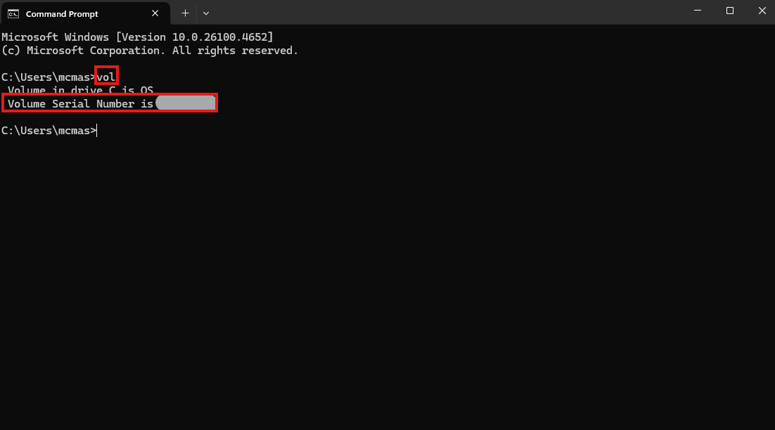
Installation Guide to Model-Based Design Toolbox BMS Series
Installation Steps: Generate and Activate NXP MBDT for BMS license
32. To find the host ID for your hard drive, please open a Windows Command Prompt and execute the vol command.

Slide 39
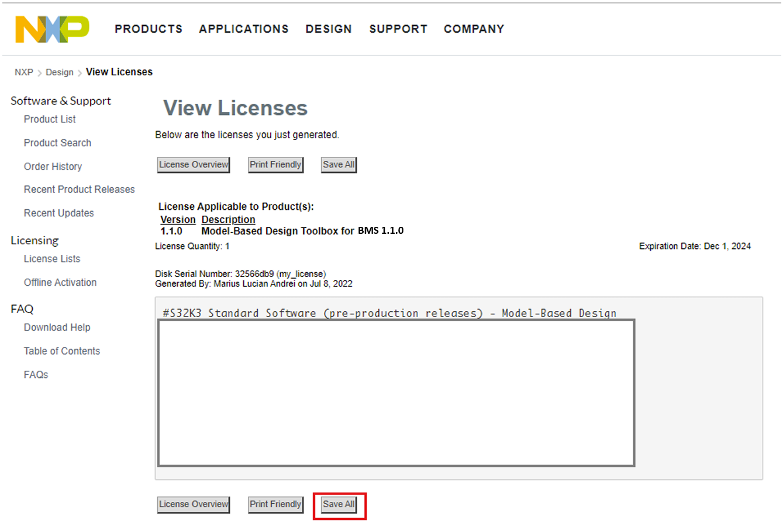
Installation Guide to Model-Based Design Toolbox BMS Series
Installation Steps: Generate and Activate NXP MBDT for BMS license
33. Now that the license has been successfully generated, press the Save All button. Save it in your computer. Remember where you save, you will need to find it later.

Slide 40
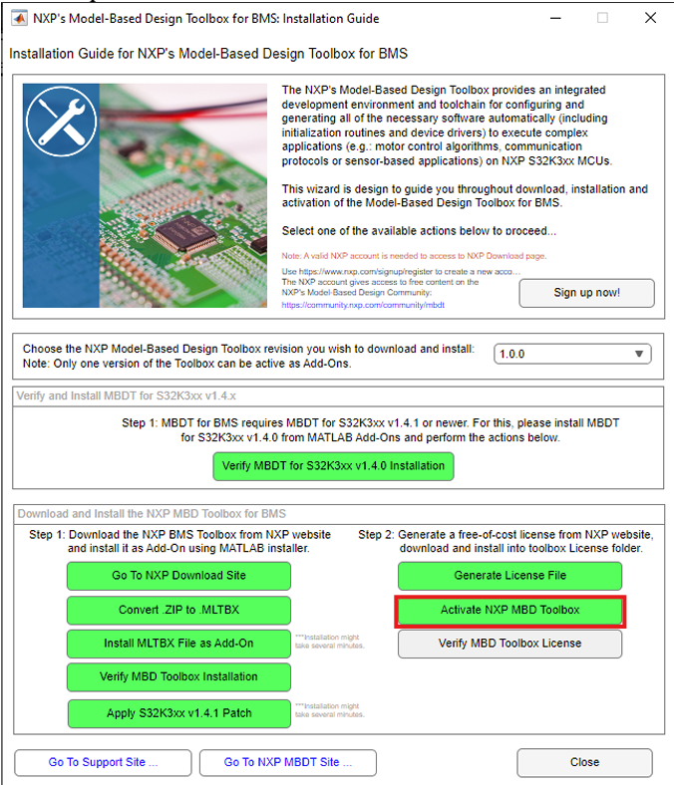
Installation Guide to Model-Based Design Toolbox BMS Series
Installation Steps: Generate and Activate NXP MBDT for BMS license
34. Back to NXP Support Package for BMS, press the Activate NXP MBD Toolbox button.

Slide 41
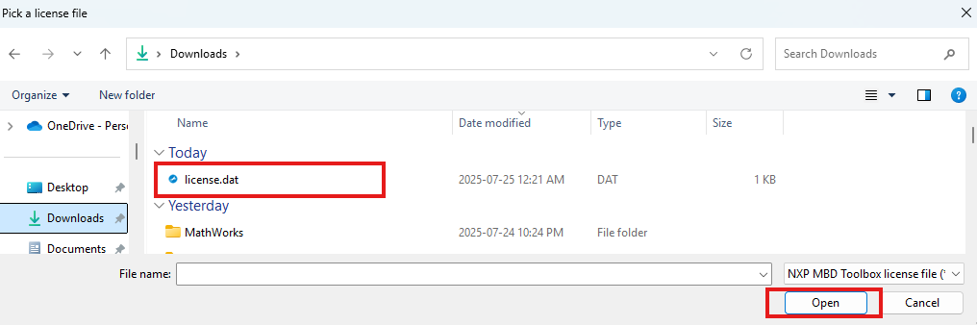
Installation Guide to Model-Based Design Toolbox BMS Series
Installation Steps: Generate and Activate NXP MBDT for BMS license
35. In the newly opened window, Browse for the downloaded license.dat or license.lic file, and press Open.

Slide 42
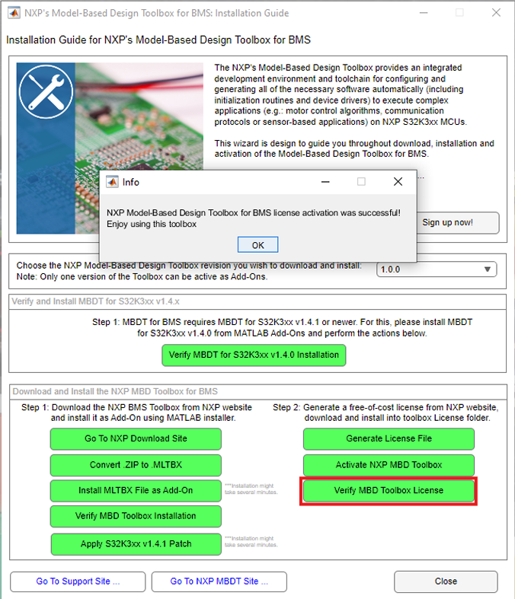
Installation Guide to Model-Based Design Toolbox BMS Series
Installation Steps: Generate and Activate NXP MBDT for BMS license
36. Final step is to check the license activation status, by pressing the Verify MBD Toolbox License button.

Slide 43
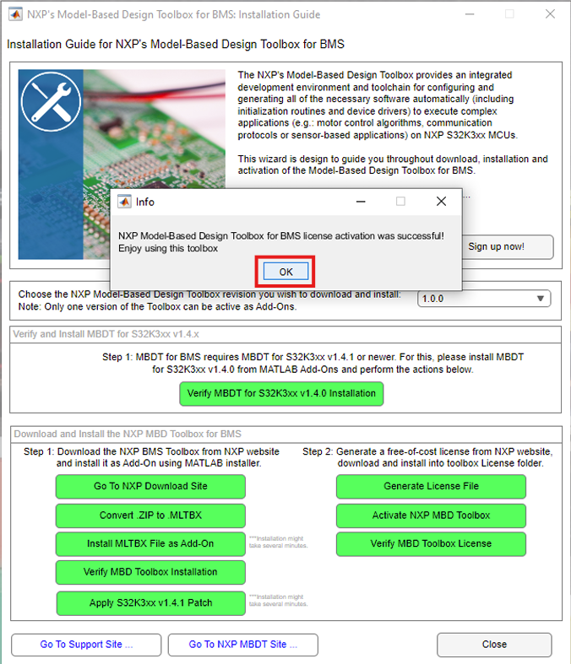
Installation Guide to Model-Based Design Toolbox BMS Series
Installation Steps: Generate and Activate NXP MBDT for BMS license
37. If everything went well, a similar popup window as below will be displayed. Press OK. Then you may close the NXP Support Package for BMS window.

Slide 44
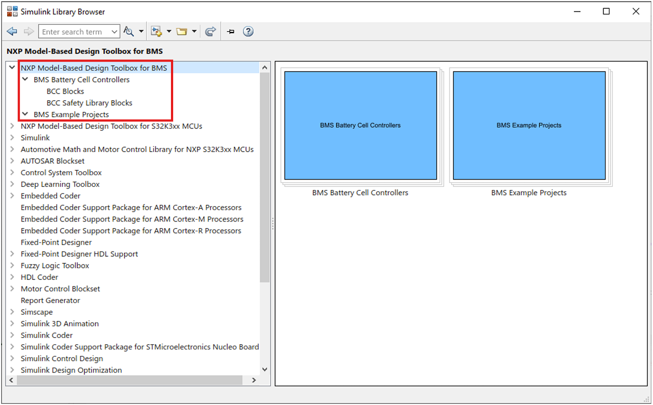
Installation Guide to Model-Based Design Toolbox BMS Series
NXP’s Model-Based Design Toolbox for BMS layout and Simulink Library are shown below.

Slide 45
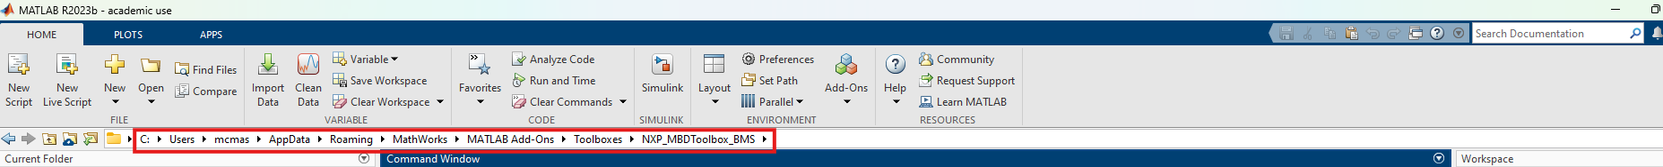
Installation Guide to Model-Based Design Toolbox BMS Series
Verification of the user setup dependencies
Running mbd_bms_path.m script will issue instructions for a successful installation and configuration of the toolbox. To run it, first go to its file location, i.e., C:\Users\mcmas\AppData\Roaming\MathWorks\MATLAB Add-Ons\Toolboxes\NXP_MBDToolbox_BMS

Slide 46
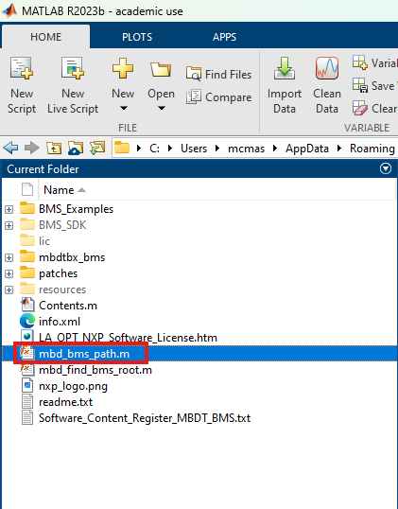
Installation Guide to Model-Based Design Toolbox BMS Series
Verification of the user setup dependencies
Open the file named mbd_bms_path.m by double-clicking it.

Slide 47
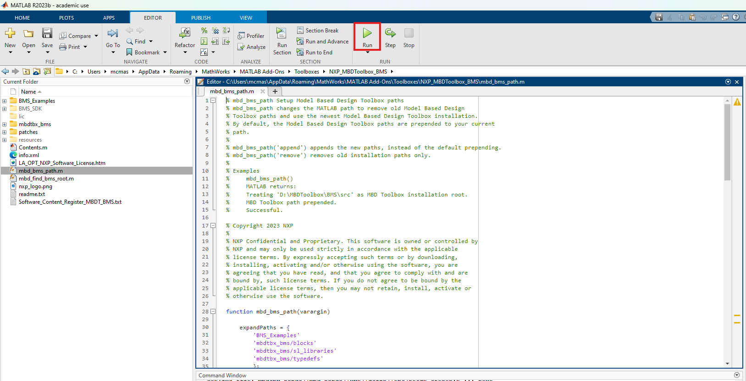
Installation Guide to Model-Based Design Toolbox BMS Series
Verification of the user setup dependencies
Run the script.

Slide 48
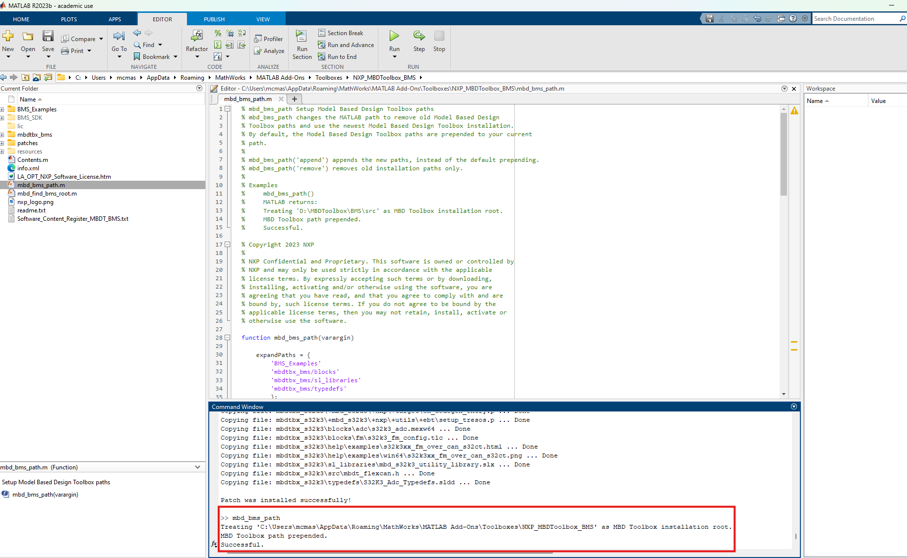
Installation Guide to Model-Based Design Toolbox BMS Series
Verification of the user setup dependencies
If the Command Window returns a Successful message, installation is successful.

Slide 49
Thank you
McMaster Automotive Resource Centre (MARC)
49

